Slide 1

Advanced Driver Assistance System (ADAS)
Prepared by:
Abhishek Tamboli

Slide 2

Table of Contents
1. Introduction to ADAS
1.1 History of ADAS
1.2 What is ADAS?
1.3 Importance of ADAS
2. Evolution and Development
2.1 Early Developments
2.2 Modern Advancements
2.3 Future Prospects
3. Features and Functionalities
3.1 Light Assisted Technology
3.1.1 Adaptive front lightning system
3.1.2 Adaptive light control
3.1.3 Intelligent high beam control

Slide 3
Table of Contents
3.2 Sensor Assisted Technology
3.2.1 Adaptive Cruise Control
3.2.2 Blind spot detection
3.2.3 Front collision avoidance system
3.2.4 Cross traffic alert
3.2.5 Hill descent control
3.2.6 Head up display
3.2.7 Lane change assist
3.3 AI Assisted Technology
3.3.1 Automatic Parking System 3.3.2 Emergency Driver Assistant
3.3.3 Intelligent Speed Adaptation
3.3.4 Some more AI Technology

Slide 4
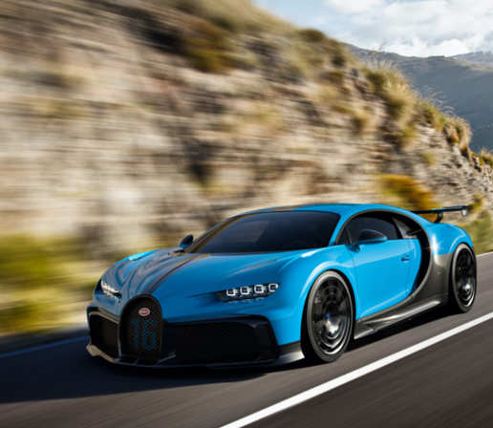
Table of Contents
3.4 Camera Assisted Technology
3.4.1 Night View Assist
3.4.2 Drowsy Driver Warning
3.4.3 Pedestrian Detection System
3.4.4 Lane Detection
3.4.5 Lane Keeping Assist
3.4.6 Traffic Sign Recognition
3.4.7 Traffic Light Recognition
3.4.8 Rear Cross-Traffic Alert
3.4.9 Surround View Park Assist
3.5 Brake Assisted Technology
3.5.1 Autonomous Emergency Braking
3.5.2 Pedestrian Automatic Emergency Braking

Slide 5
Table of Contents
4. Working Principles
4.1 Sensors
4.2 Data Processing
4.3 Decision-Making
4.4 Actuators
5. ADAS Architecture
5.1 System Level Design
5.2 ADAS architecture
5.3 Sensor Layer Architecture
6. Levels of ADAS
6.1 Level 0 - No Automation
6.2 Level 1 - Driver Assistance
6.3 Level 2 - Partial Automation
`

Slide 6
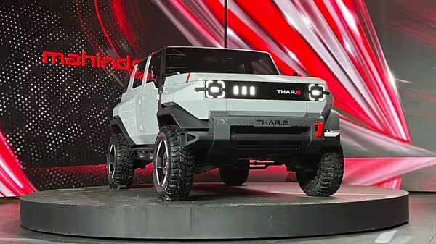
Table of Contents
6.4 Level 3 - Conditional Automation
6.5 Level 4 - High Automation
6.6 Level 5 - Full Automation
7. Challenges and Concerns
7.1 Safety and Reliability
7.2 Cybersecurity
7.3 Legal and Ethical Issues
7.4 Cost and Accessibility
8. Market Overview
8.1 Key Players

Slide 7
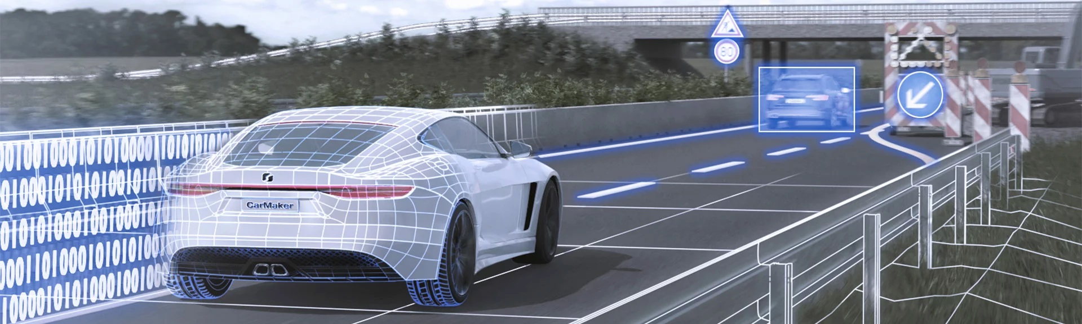
Introduction to ADAS

Slide 8
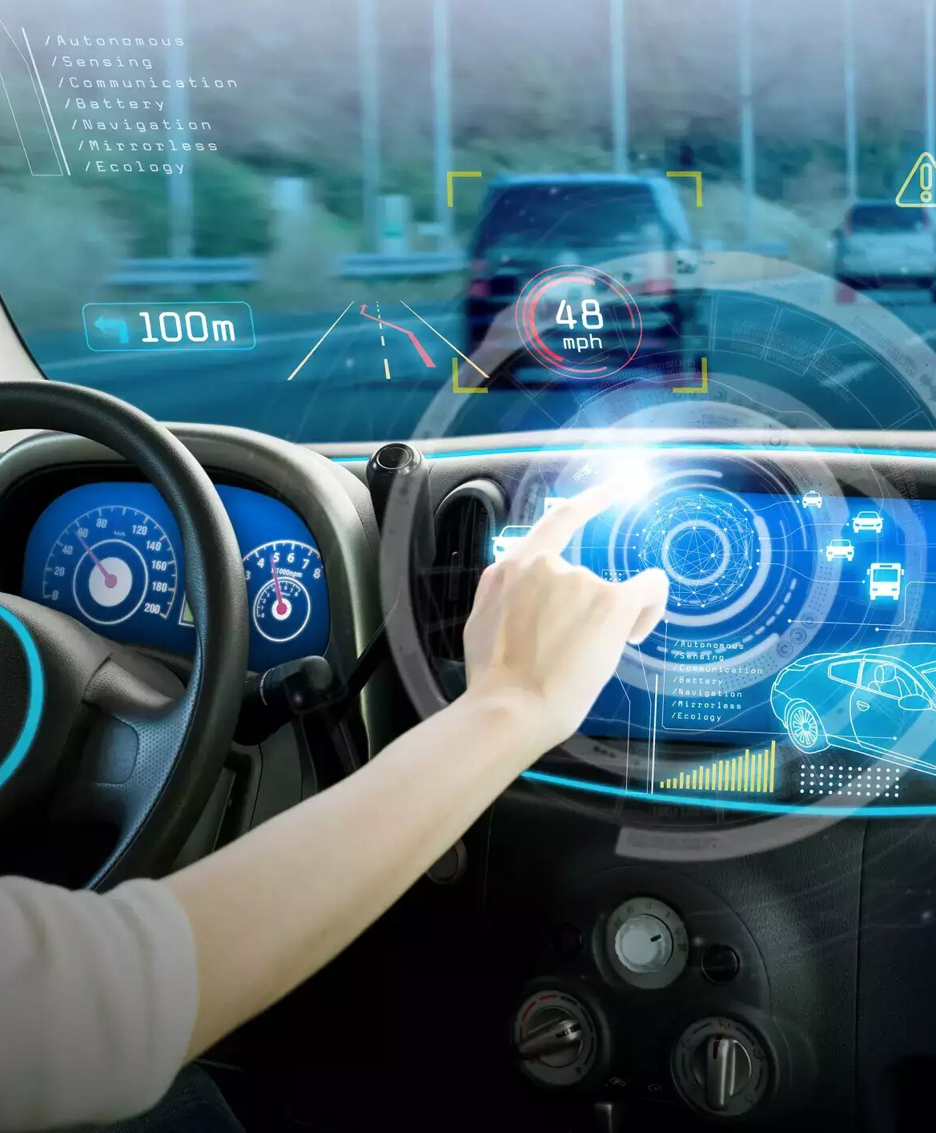
History of ADAS
1950s - Cruise Control
1970s - Anti-lock Braking Systems (ABS)
1980s – Airbags
1990s - Traction Control Systems (TCS)
Late 1990s - Electronic Stability Control (ESC)
2000s - Parking Assistance, Adaptive Cruise Control (ACC)
2010s - Lane Departure Warning (LDW), Lane Keeping Assist (LKA), Collision Avoidance, Automatic Emergency Braking (AEB) and Advanced Driver Assistance Systems (ADAS)
2020s - Continued Advancements
Future - Towards Autonomous Driving

Slide 9
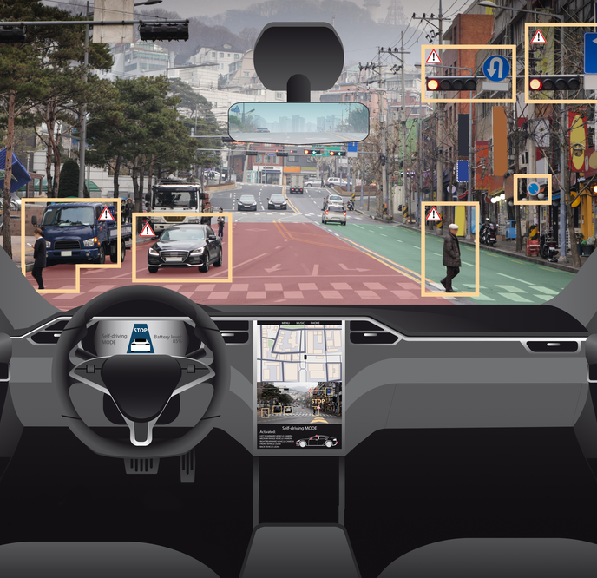
What is ADAS
ADAS, or Advanced Driver Assistance Systems
These are technologies designed to enhance vehicle safety and improve the driving experience by providing assistance and automation in various driving tasks.
These systems use sensors, cameras, radar, and other technologies to monitor the vehicle's surroundings and assist the driver.

Slide 10
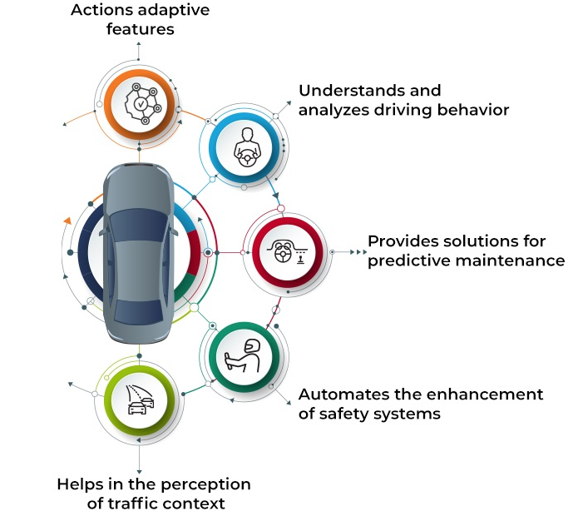
Importance of ADAS
ADAS systems play a crucial role in reducing accidents, enhancing driver comfort, and paving the way for autonomous driving.
They are seen as a bridge between traditional driving and fully autonomous vehicles, making roads safer and more efficient.

Slide 11

Evolution and Development

Slide 12
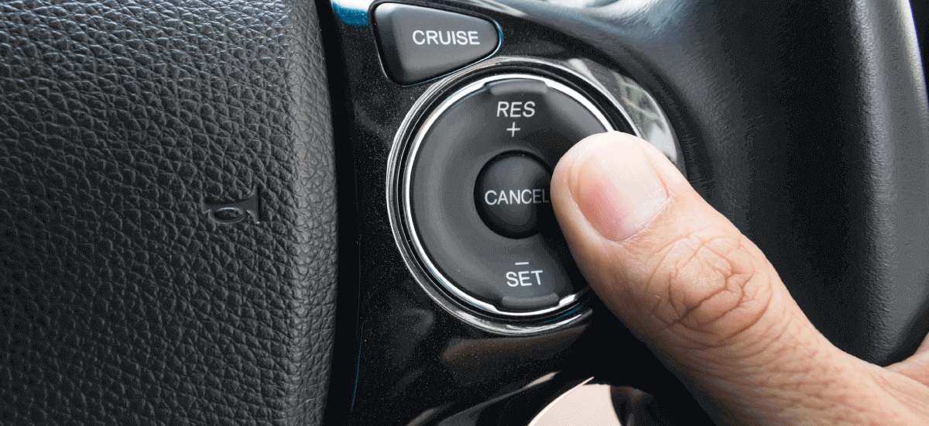
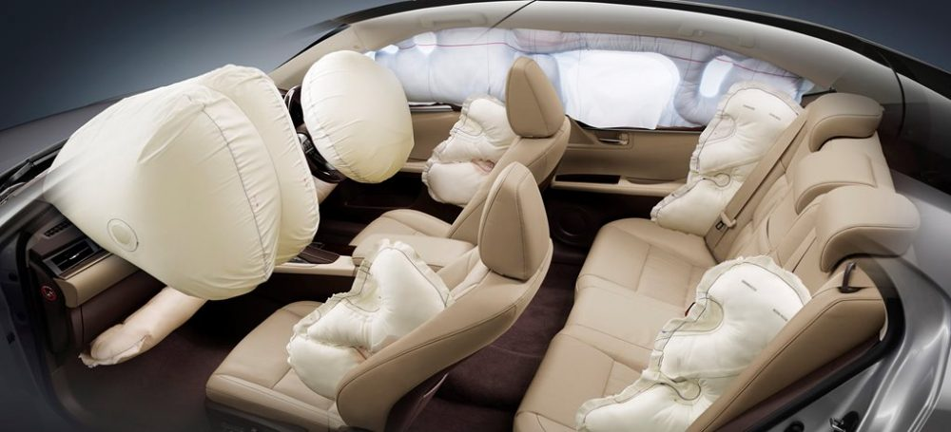
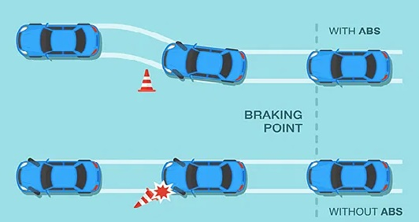
Early Developments
Early ADAS features laid the foundation for more advanced features we see today.
Cruise control
Airbags
Antilock braking system

Slide 13
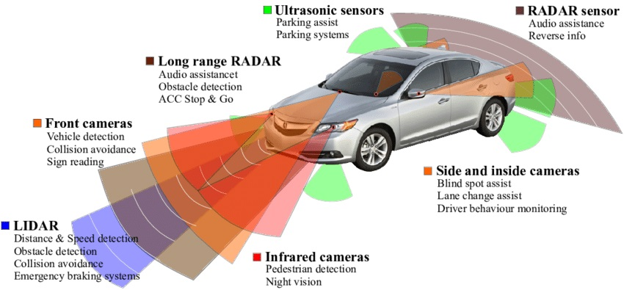
Slide 27
Modern Advancements

Slide 14
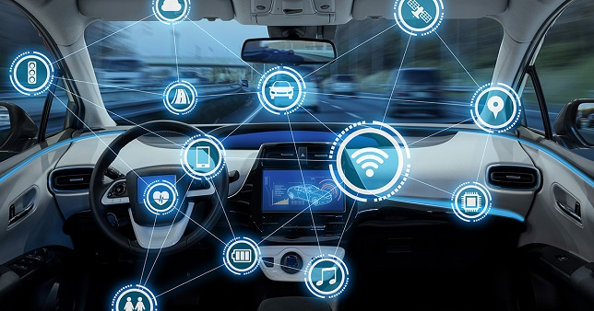
Future Prospects
The development of ADAS continues, with a focus on improving sensing technology, data processing, and decision-making algorithms.
Future prospects include greater integration with autonomous vehicles and enhanced safety measures.

Slide 15
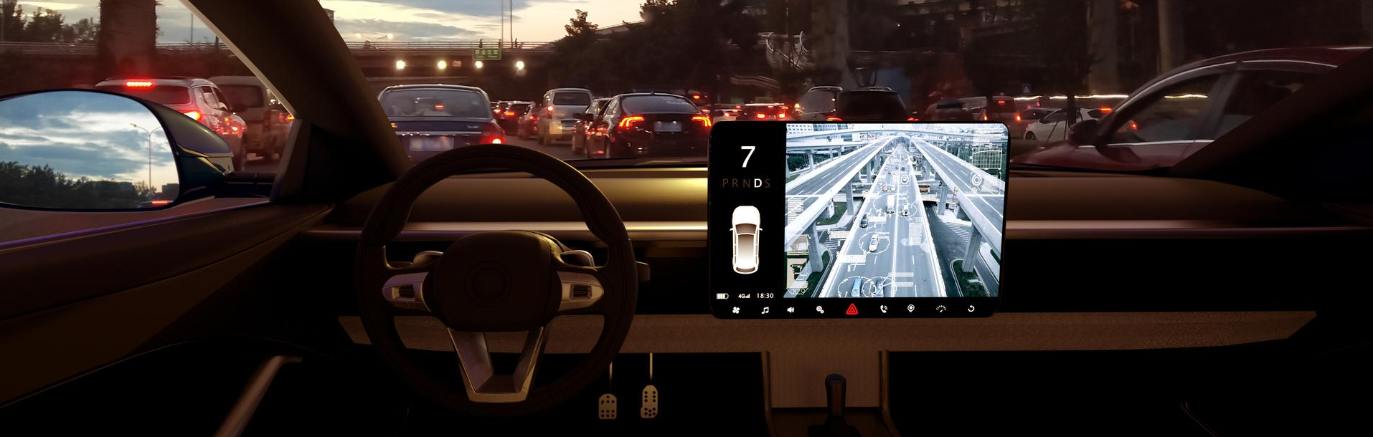
Features and Functionalities

Slide 16
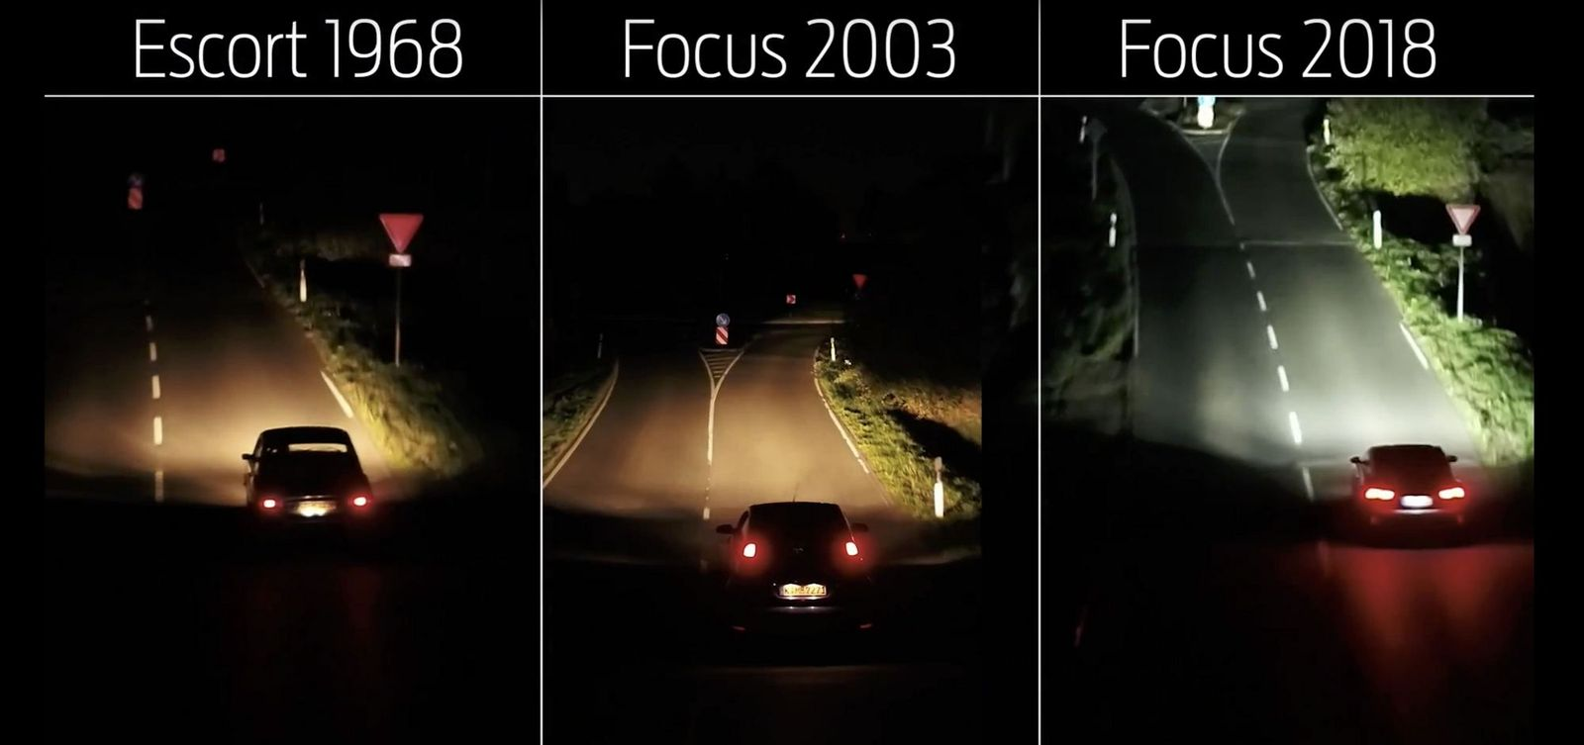
Light Assisted Technology

Slide 17
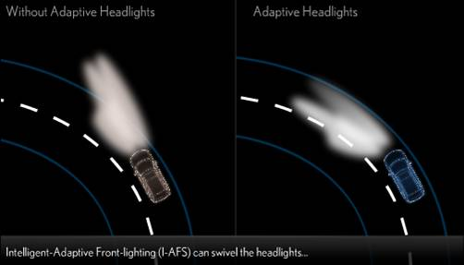
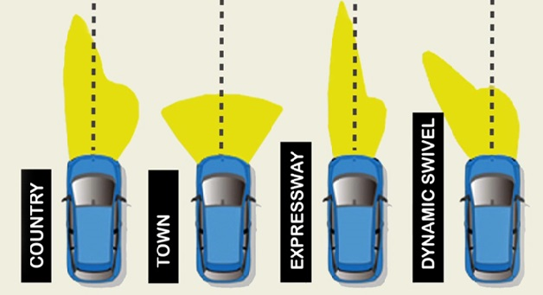
System that automatically turns the headlight beam to the right or left dependent on the vehicle’s direction.
AFLS - Adaptive Front Lighting System

Slide 18
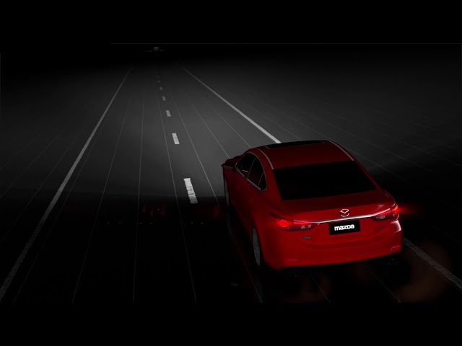
Detects oncoming traffic and vehicles in front, automatically adjusting the headlamp beam high and low.
AHBC – Adaptive High Beam Control
ALC - Adaptive Light Control

Slide 19
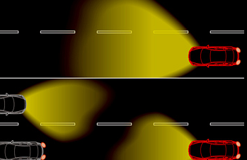
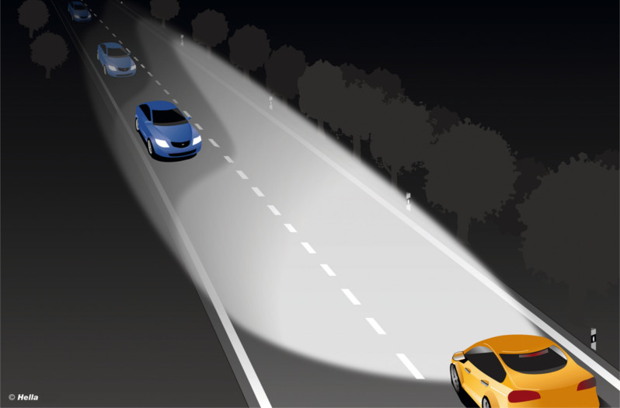
IHBC - Intelligent High Beam Control
Allows driving with the high beam on at all times. If the camera detects other traffic on the road, the distribution of light from the high beams is adjusted so as not to blind the approaching driver.

Slide 20
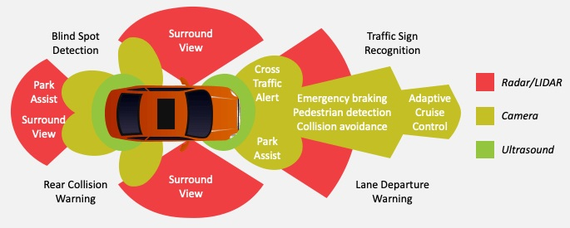
Sensor Assisted Technology

Slide 21
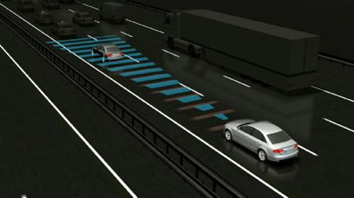
Cruise control system automatically adapts speed to maintain a safe distance from vehicles in front.
ACC – Adaptive Cruise Control

Slide 22
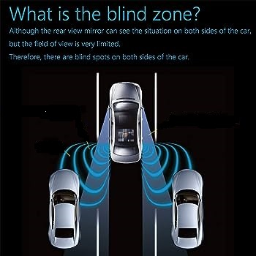
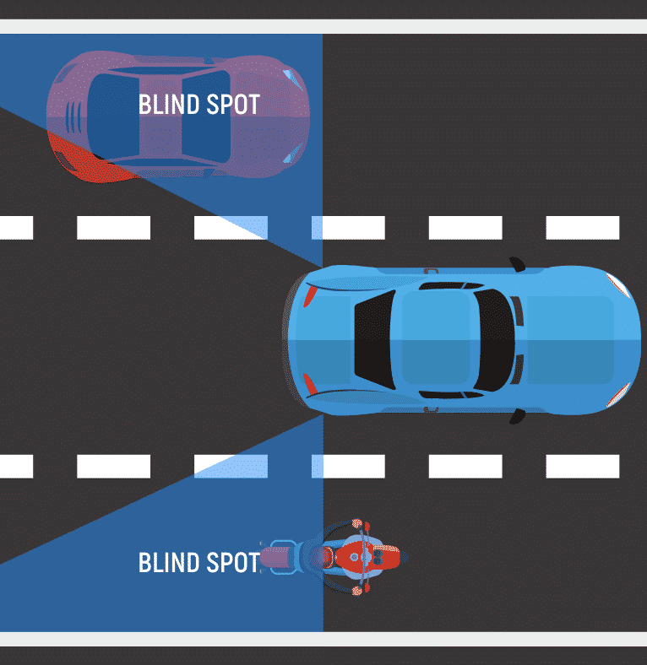
BSD – Blind Spot Detection
These systems provide vital information about blind spots, areas that cannot be seen easily by the driver.
Some of these systems will sound an alarm if they sense the presence of an object within a blind spot
Others include cameras that transmit images to a display in the dashboard.

Slide 23
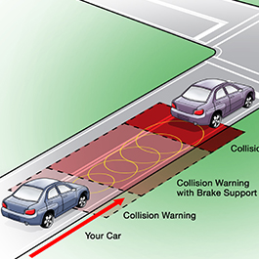
FCAS – Front Collision Avoidance System
Uses a variety of sensors to determine whether a vehicle is in danger of colliding with another object.
These systems sense the proximity of other vehicles, pedestrians, or other objects on the road.
When the vehicle is in danger of colliding with another object, the collision avoidance system will warn the driver and take preventive actions, such as pre-charging the brakes, applying tension to the seat belts, or taking over steering

Slide 24
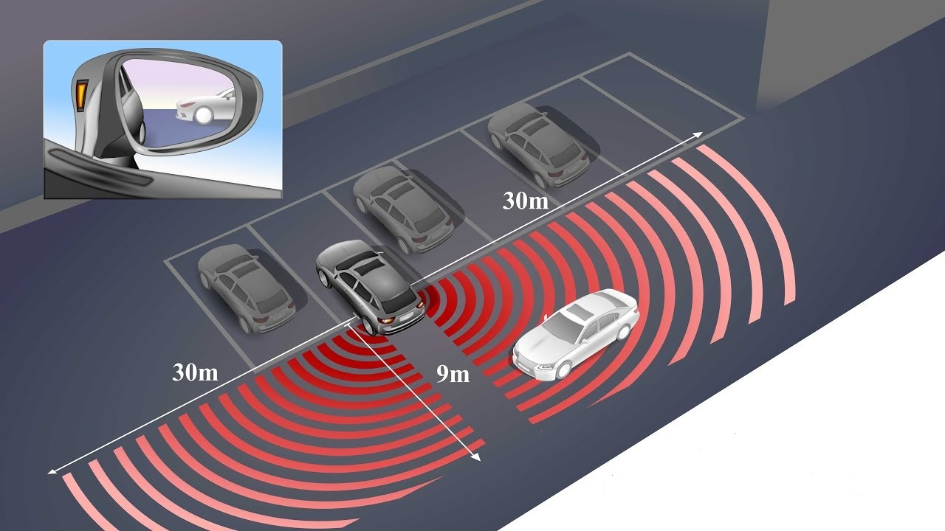
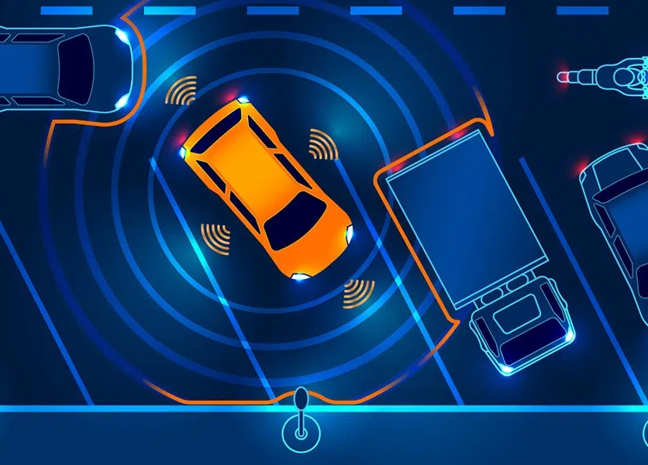
CTA – Cross-Traffic Alert
Multiple sensors or wide angle cameras are located near the front or rear of the vehicle, detecting traffic that comes from the side, typically in car park situations.

Slide 25
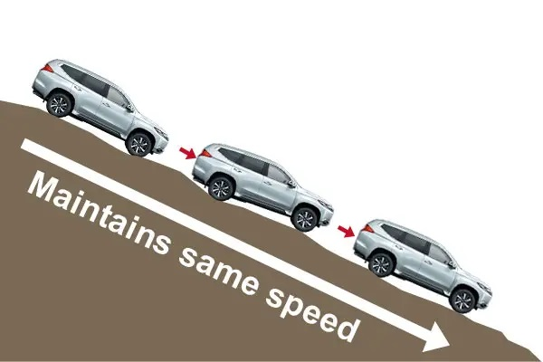
A system that adjusts speed by applying the brake or shifting to lower gears while driving down a hill.
HDC – Hill Descent Control

Slide 26
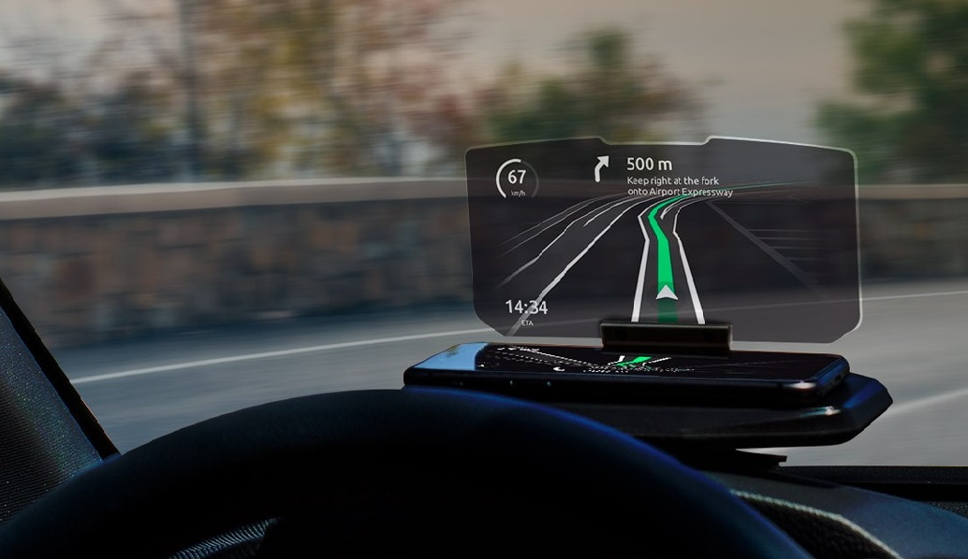
HUD – Head Up Display
A transparent display that shows information on the front windscreen, allowing drivers to keep their eyes on the road, instead of having to look away toward information on the dashboard

Slide 27
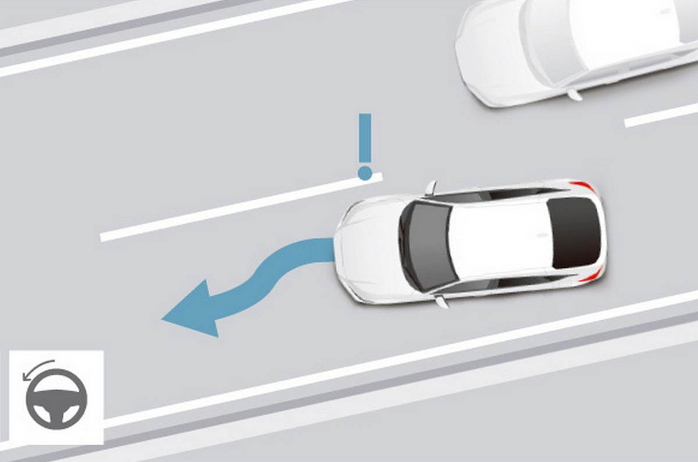
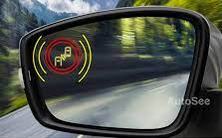
LCA – Lane Change Assist
Senses a vehicle approaching in a neighboring lane while you signal for a lane change. The vehicle can alert the driver with a flashing indicator in the side mirror

Slide 28

AI Assisted Technology

Slide 29
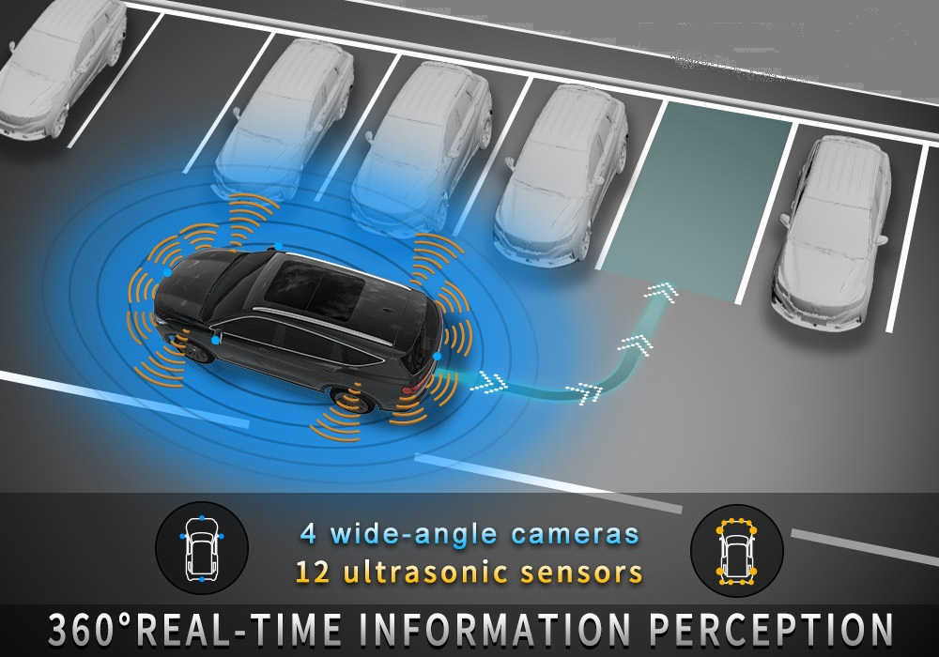
APS – Automatic Parking System / PA - Parking Assistance/ IPAS - Intelligent Assist System
Designed to help a driver park.
Some perform the entire job automatically, while others simply provide advice so that the driver knows when to turn the steering wheel and when to stop.

Slide 30
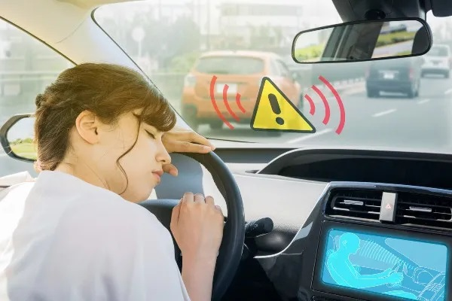
EDA – Emergency Driver Assistant
A system that monitors driver behavior.
If the system concludes that the driver is no longer able to safely drive the vehicle, the EDA takes control of the brakes and the steering to bring the vehicle to a stop.

Slide 31
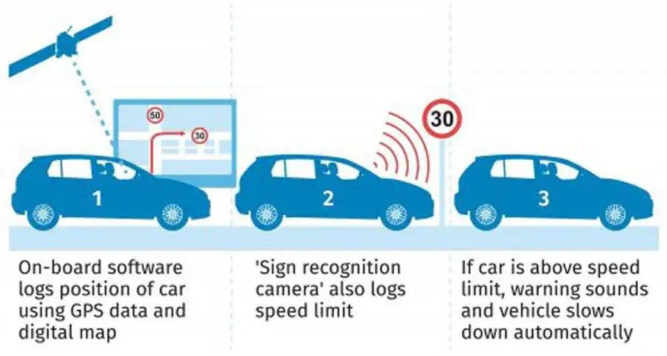
ISA – Intelligent Speed Adaptation
A system that monitors vehicle speed, warning the driver to adjust their speed if it is higher than the allowed limit.
Typically uses Traffic Sign Recognition and map data to determine the speed limit.

Slide 32
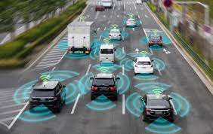
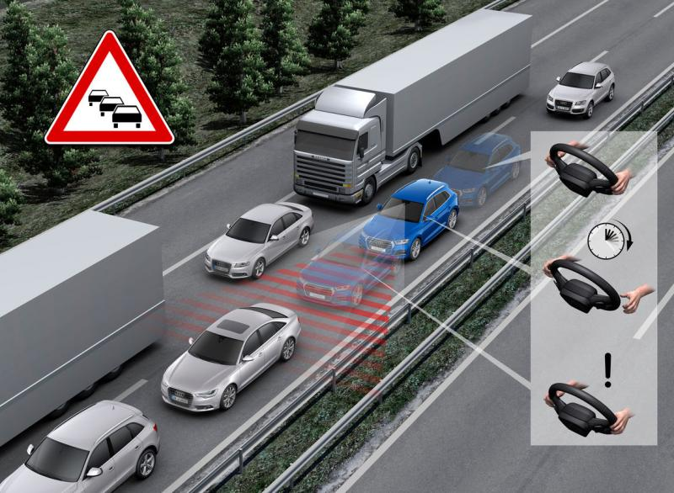
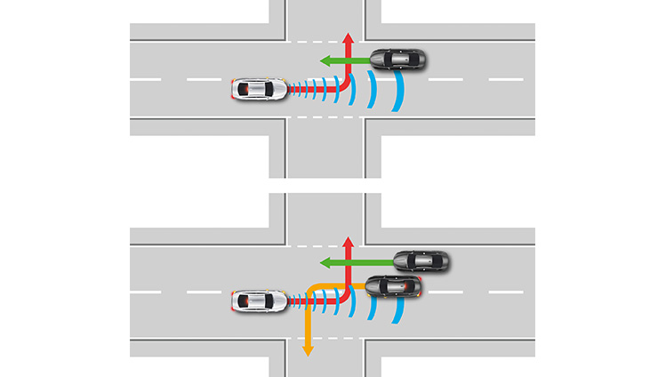
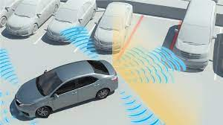
Some more AI Assisted Technology
Semi-Autonomous Driving (SAD)
Traffic Jam Assist (TJA)
Turning Assistant (TA)
Ultrasonic Park Assist (UPA)
A driving system that is primarily autonomous, but requires the driver to monitor and take control of the vehicle in case the automated driving system cannot safely operate the vehicle.
Keeps the vehicle at a safe distance, adapts speed and optionally takes control of steering in lower-speed, dense traffic situations.
Monitors traffic when turning at low speeds, even autonomously applying the brakes in unsafe situations.
A Parking Assist system that solely uses ultrasonic sensors. Ultrasonic sensors, which detect distance, but can’t detect smaller objects well, nor can they find parking spot markers.

Slide 33
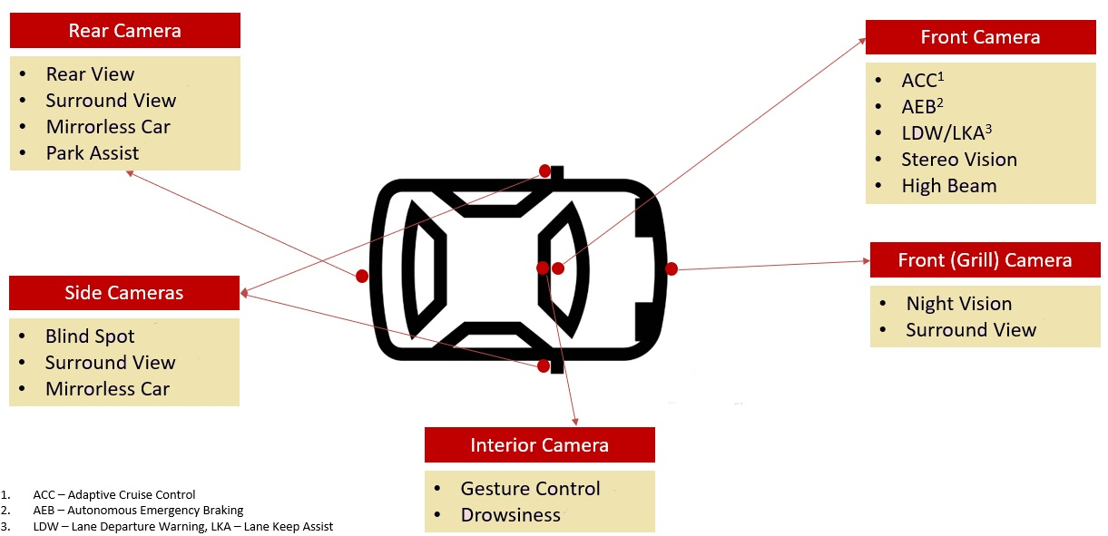
Camera Assisted Technology

Slide 34
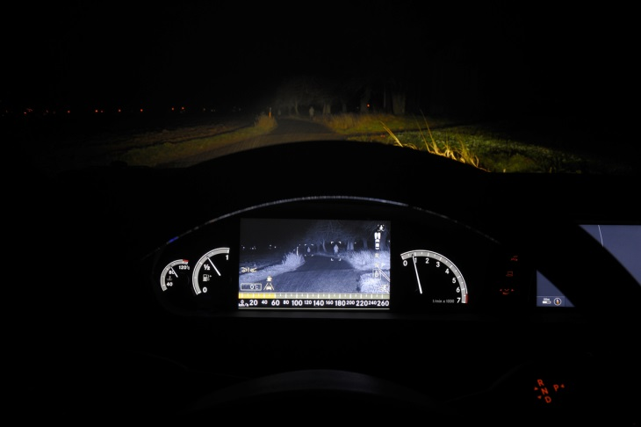
NVA - Night View Assist
Captures images using a thermal camera or active infrared lighting and presents it on a dashboard display.
This increases the driver’s perception and viewing distance at night.

Slide 35
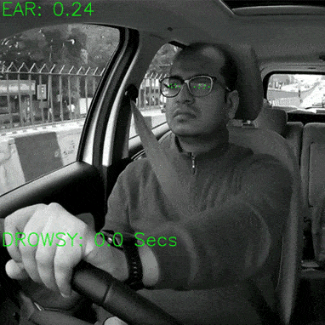
DDW – Drowsy Driver Warning / DFW – Driver Fatigue Warning
Use cameras or other sensors to determine if a driver’s attention is still on the road and operating the vehicle safely.
Most systems track eye blinking rates and gaze direction whilst others look for the driver’s head to nod in a tell-tale motion that indicates sleepiness.
When this happens typically a warning buzzer will sound, then progress to a louder noise with a light displayed on the dashboard.
This continues until the driver interacts with the system to cancel it

Slide 36
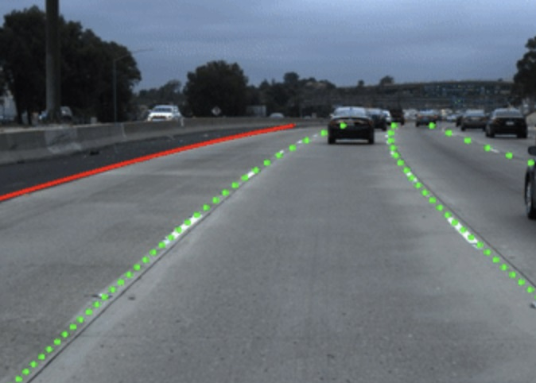
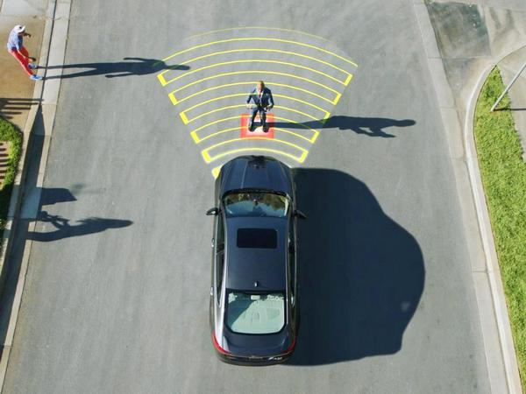
LD – Lane Detection
PDS – Pedestrian Detection System
Uses a forward camera to detect lane markings on the road.
A system that detects pedestrians in front or behind the vehicle, usually through the use of cameras.

Slide 37
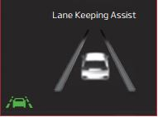
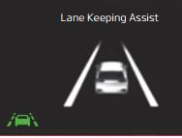
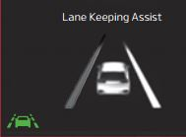
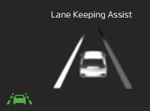
LKA - Lane Keeping Assist
1. When the front camera does not detect the lane traveling in, the lanes are not illuminated.
2. When the front camera does not detect the lane traveling in, the lanes are not illuminated.
3. When the front camera detects the vehicle moving outside of the right lane traveling in, a vehicle crossing right lane indicator will blink.
4. When the front camera detects the vehicle moving outside of the left lane traveling in, a vehicle crossing left lane indicator will blink.

Slide 38
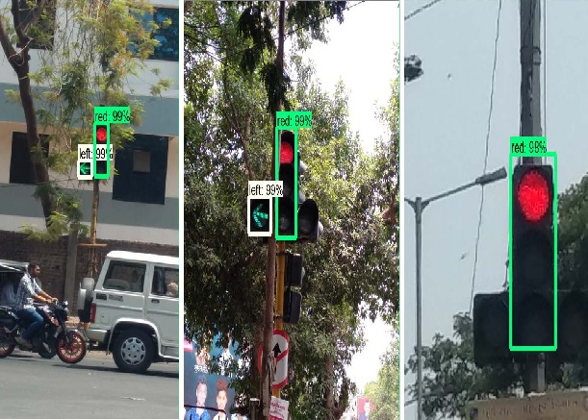
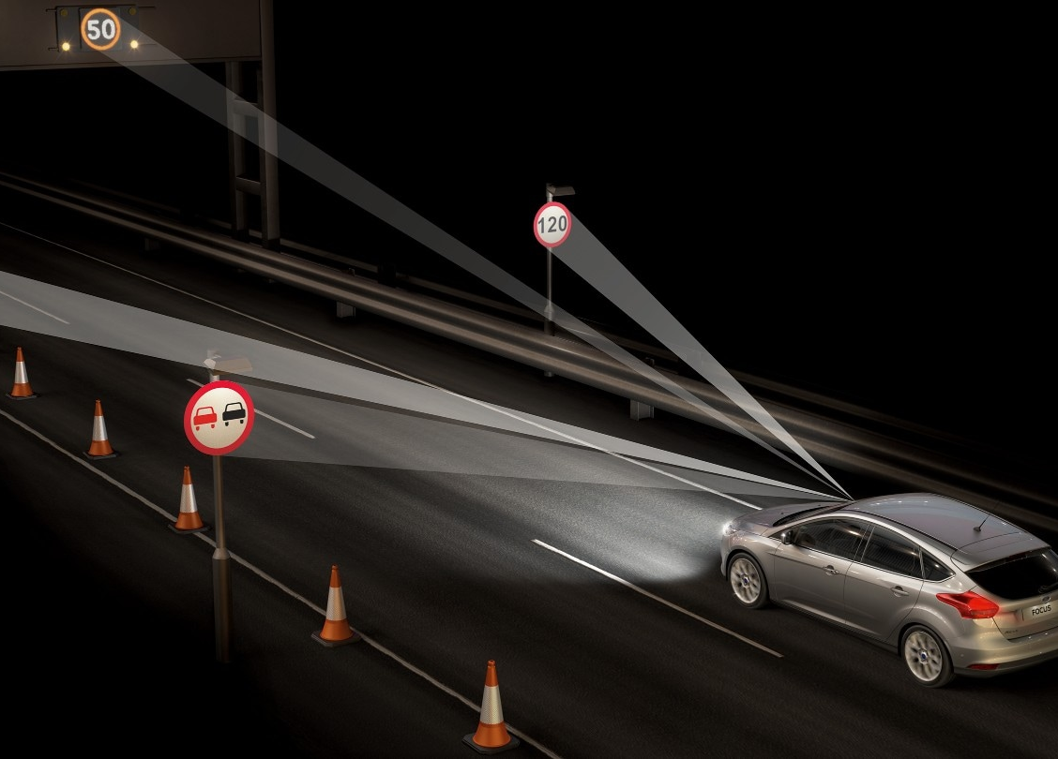
TSR – Traffic Sign Recognition
A camera-based technology that detects and analyses the traffic signs next to the road. Speed limit signs can for instance be used to control the speed of the vehicle.
TLR – Traffic Light Recognition
A camera-based technology that detects and analyses traffic lights, either to inform the driver or to provide information to the vehicle for autonomous driving.

Slide 39
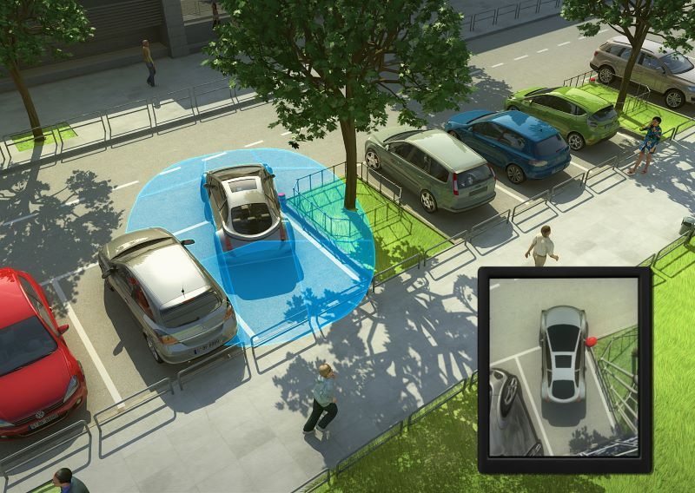
RCTA – Rear Cross-Traffic Alert
SVPA - Surround View Park Assist
These systems detecting traffic that comes from the side, typically in car park situations.
Capture and display the area surrounding the vehicle in a single integrated view on a display in the dashboard

Slide 40
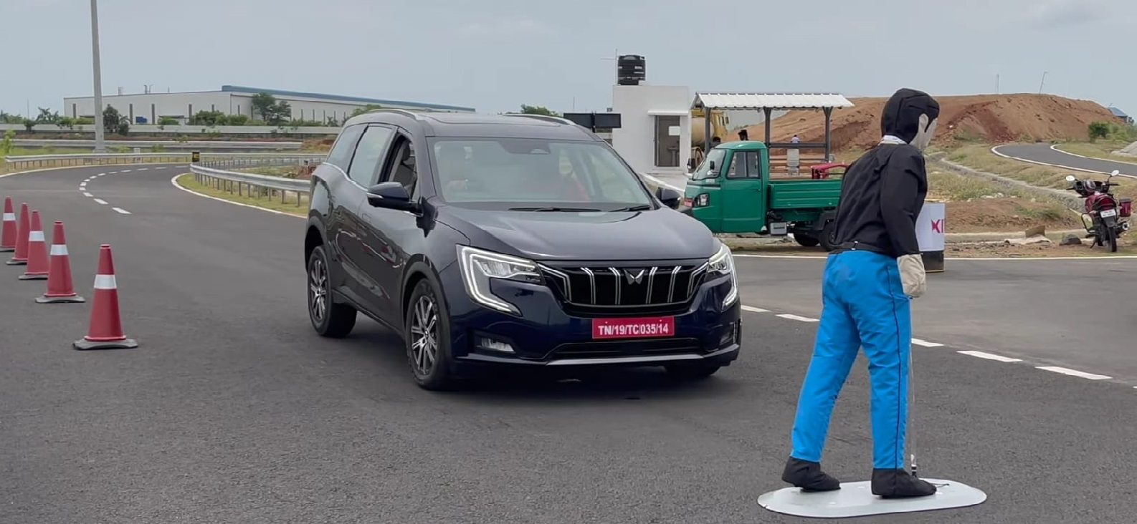
Brake Assisted Technology

Slide 41
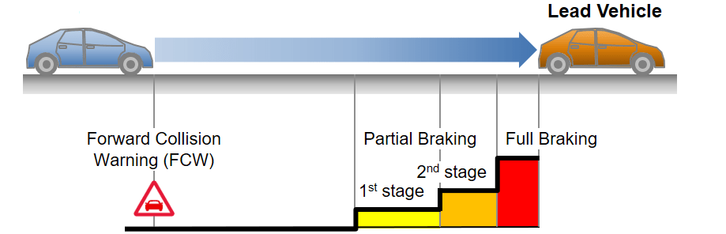
AEB –Autonomous Emergency Braking
Monitors the proximity of vehicles in front, detecting situations where a collision is imminent. Braking is then automatically applied to avoid the collision or mitigate its effects.

Slide 42


PAEB – Pedestrian Automatic Emergency Braking
A system that performs automatic braking if a pedestrian is detected in front of the vehicle.

Slide 43
Working Principles

Slide 44

Sensors
Camera systems
LiDAR system
Radar system
GNSS/IMU system

Slide 45

Camera System

Slide 46

Monocular Cameras
Monocular cameras are single-lens cameras that capture 2D images.
They are a common component of ADAS systems and are often integrated into the rearview mirror or near the windshield.
Features:
Advanced Emergency Braking (Vehicle/ Pedestrian/ Cyclist)
Emergency Lane Keeping (ELK)
Features:
Traffic Sign Assist
Event Data Recorder (EDR)
Adaptive Cruise Control
Traffic Jam Assist
Traffic Light Recognition
Continuous Lane Centring Assist
Head Light Assist

Slide 47

Stereo Cameras
Features:
Forward Collision Warning (FCW)
Pedestrian Detection
Obstacle Detection
Stereo cameras use two lenses, typically separated by a small distance, to capture images.
Stereo cameras capture two slightly offset images of the same scene, simulating the difference in perspective seen by each eye.
The disparities in the images are analyzed to calculate the depth and distance of objects in the scene.

Slide 48

Multipurpose Cameras(BOSCH)
It enables vehicles to reliably detect objects and people at all times.
The multi purpose camera for assisted and partially automated driving utilizes an innovative, high-performance system-on-chip (SoC) with a Bosch microprocessor for image-processing algorithms.
Features:
Lane departure warning
Lane keeping assist
Road sign information
Intelligent headlight control
Automatic emergency braking

Slide 49




Working of Camera system
1. Image Capture:
The camera continuously captures images or video frames of the road and its surroundings.
3. Decision-Making: The processed data is used to make decisions regarding various ADAS functions.
4. Driver Alerts and Control: The camera can issue driver alerts, such as visual and audible warnings, or it can directly control vehicle systems
2. Image Processing: These images are processed in real-time by onboard computers using sophisticated algorithms.

Slide 50
LiDAR System

Slide 51


Working
LiDAR Techniques
LiDAR (light detecting and ranging, or “light radar”) sensor.
It send One or more laser beams at a high frequency and use the Time-of Flight principle to measure distances. LiDAR capture a high resolution point cloud of the environment.

Slide 52

RADAR System

Slide 53

RADAR sensor
RADAR (RAdio Detection and Ranging) is used for the detection and location of objects in the presence of interference; i.e., noise, clutter and jamming.
The radio signal can the form of “Pulsed” or “Continuous Wave”.
Automotive radars utilize Linear FM signal, Frequency Modulated Continuous Wave (FMCW)

Slide 54

RADAR Techniques
Comparison metrics:
1. Range
2. Field of view
3. Position and speed accuracy
Configurations:
1. Wide-FOV: Short Range
2. Narrow-FOV: Long Range
Radar Types
1. Front Radar Sensor
2. Corner Radar Sensor

Slide 55

GNSS/IMU Positioning System

Slide 56

Global Navigation Satellite Systems and Inertial Measurement Units
Direct measure of vehicle states like Positioning, velocity, and time (GNSS)
Varying accuracies: Real-time Kinematic (RTK-short base line), Precise Point Positioning (PPP), Differential Global Positioning System (DGPS), Satellite-based augmentation system (SBAS-Ionospheric delay correction)
Angular rotation rate (IMU)
Acceleration (IMU)
Heading (IMU, GPS)

Slide 57

Data Processing
Sensor Data Collection
Data Pre-processing
Sensor Fusion
Object Detection and tracking
Data Analysis

Slide 58

Sensor Data Collection
ADAS systems rely on a variety of sensors, including radar, lidar, ultrasonic sensors, and cameras.
It continuously collect data about the vehicle's surroundings and its own state.
Sensors provide information about nearby vehicles, pedestrians, road conditions, lane markings, traffic signs, and more.

Slide 59

Data Preprocessing
Raw sensor data is often noisy and may contain errors or outliers.
Data preprocessing is the initial step, which involves cleaning and conditioning the data to ensure its quality and reliability.
This process includes tasks like filtering out irrelevant data, removing outliers, and calibrating sensors.

Slide 60
Sensor Fusion

Slide 61

Sensor Fusion
Sensor fusion algorithms integrate and synchronize data from different sensors to improve object detection and tracking.
Types of Sensor Fusion
1. Low Level Fusion
2. Mod Level Fusion
3. High Level Fusion

Slide 62

Low Level Fusion
Low Level Sensor Fusion is about fusing the raw data coming from multiple sensors.
At each millisecond, we can fuse hundreds of thousands of points with hundreds of thousands of pixels.
In the example below, Object detection involves projecting the 3D point clouds into the image and then associating this information with the pixels.

Slide 63

Mid Level Fusion
Mid-Level sensor fusion is about fusing the objects detected independently on sensor data.
If a camera detects an obstacle, and a radar detects it, we'll fuse these results to have the best estimate of the position, class, and velocity of the obstacle.
In this example below, fusing 3D bounding boxes from a LiDAR with a 2D bounding box from an object detection algorithm.

Slide 64

High Level Fusion
High level sensor fusion is about fusing both objects and their trajectories. We're not only relying on detections, but also on predictions and tracking.
This process is one level higher, and thus benefits the same simplicity advantages.

Slide 65


Object Detecting and Tracking
Data processing includes object detection algorithms that identify and classify objects in the vehicle's vicinity. This can include other vehicles, pedestrians, cyclists, and obstacles.
Object tracking algorithms monitor the movement of these objects over time, predicting their future positions.

Slide 66

Data Analysis
Once the data is preprocessed, it is analyzed in real-time or near-real-time.
Advanced analysis techniques, including computer vision and machine learning, are applied to interpret the data.
Object recognition algorithms identify the type of objects (e.g., car, truck, pedestrian) and their attributes (e.g., speed, direction).
Behavior prediction models estimate how objects are likely to move, enabling the system to anticipate potential collisions or hazards.

Slide 67

Decision Making

Slide 68

Decision Making process

Slide 69


Decision making process explanation
Decision making process broken down into three hierarchical level:
1. Route Planning: It is also known as route planner is in charge of finding the optimal global route from a given source to destination taking into account the predefined criteria such as fastest route, shortest route, minimum travel time, and fuel efficiency.
2. Behavioral Planning: The vehicle follows road rules and interacts with other agents in a conventional, safe manner while making incremental progress towards the route determined by the mission planner.
3. Motion Planning: after making the decisions, the motion planner, also known as the local planner, plans a set of actions, a suitable collision-free path, and a detailed trajectory for some period of future time allowing AV to reach its higher-level goals while avoiding the collision.

Slide 70

Actuators

Slide 71

Steering System
This actuator assists in steering control by applying an electric motor's force to the steering mechanism.
It can vary the level of assistance based on the vehicle's speed and the driving situation, making steering more manageable and responsive.

Slide 72

Brake System
These actuators control the vehicle's braking system to assist with functions like automatic emergency braking (AEB) and adaptive cruise control (ACC).
They can modulate brake pressure or apply the brakes in response to sensor inputs to avoid collisions or maintain a safe following distance.

Slide 73




More Actuator system
Powertrain system
Transmission Actuators
Throttle Actuators
Suspension system

Slide 74

ADAS Architecture

Slide 75

System-Level Design

Slide 76

ADAS Architecture

Slide 77

Sensor Layer Architecture

Slide 78

Levels of ADAS

Slide 80




Levels of ADAS Explanation
Most vehicles on the road today are Level 0: manually controlled. The human provides the "dynamic driving task" although there may be systems in place to help the driver.
The vehicle features a single automated system for driver assistance, such as Adaptive cruise control, where the vehicle can be kept at a safe distance behind the next car, qualifies as Level 1
The vehicle can control both steering and accelerating/decelerating. Here the automation falls short of self-driving because a human sits in the driver’s seat and can take control of the car at any time.

Slide 81




Levels of ADAS Explanation
Level 3 vehicles have “environmental detection” capabilities and can make informed decisions for themselves, such as accelerating past a slow-moving vehicle. But they still require human override.
Level 4 vehicles can intervene if things go wrong or there is a system failure. In this sense, these cars do not require human interaction in most circumstances. However, a human still has the option to manually override.
Level 5 vehicles do not require human attention―the “dynamic driving task” is eliminated. Level 5 cars won’t even have steering wheels or acceleration/braking pedals.

Slide 82



Challenges and Concerns
Safety and Reliability
Legal and Ethical Issues
Cybersecurity
Cost and Accessibility
Any system failures or malfunctions can potentially lead to accidents and endanger lives.
Determining who is responsible in the event of an accident involving ADAS technology can be complex.
Unauthorized access to ADAS systems can lead to malicious control of vehicles, posing a severe safety threat.
Protecting the privacy of driver and vehicle data is essential.
The high cost of ADAS technology can limit its accessibility to all drivers, particularly in older vehicles or for those on a tight budget. Key points include Initial cost, maintenance cost etc.

Slide 83






Key players

Slide 84

Thank you

